Slide 1
Chapter Ten*
Classes and Object-Oriented Programming
*Based on Starting Out with Python by Tony Gaddis

Slide 2
Chapter Ten – Classes and OOP
10.1 Procedural and Object-Oriented Programming
10.2 Classes
10.3 Working With Instances
10.4 Techniques for Designing Classes

Slide 3
Procedural and Object Oriented Programming
There are two methods of writing programs in use:
Procedural – centered on procedures or actions that occur in a program such as gathering input from user, performing calculations, reading from or writing to a file.
Object Oriented – centered on objects which are created from abstract data types that encapsulate data and functions together
The earliest programming languages were procedural as is the programming we have done thus far
Procedures operate on data items that are separate from the actions that involve the data items
The separation of data from code can lead to problems as the programs become larger and more complex

Slide 4
Procedural and Object Oriented Programming
Example: You have been working on an accounting system that references customer name, address, and phone number which are stored in three variables.
You have designed several functions that use these variables throughout the accounting system
As part of a design change, the senior programmer informs you that these variables will now be stored in a list
This means that you have to change all the functions that use these variable, which might be numerous
Not only is this a lot of work, it would be easy to make errors when changing code in so many functions
Object Oriented programming addresses this issue

Slide 5
Procedural and Object Oriented Programming
Object oriented programming is centered on creating objects rather than procedures
An object is a software entity that contains both data and procedures
Data attributes are what make up the data part of the object. They are variables that reference data.
Methods are functions that perform operations on the object’s data attributes
The object is a self-contained unit that consists of data attributes and methods

Slide 6
Procedural and Object Oriented Programming

Slide 7
Procedural and Object Oriented Programming
OOP addresses code and data separation through encapsulation and data hiding
Encapsulation refers to the combining of data and code into a single object
Data hiding refers to an object’s ability to hide its data attributes from code that is outside the object
Only the object’s methods may directly access and make changes to the object’s data attributes

Slide 8
Procedural and Object Oriented Programming
An object hides its data but allows outside code to access its methods.

Slide 9
Procedural and Object Oriented Programming
Access to an object’s data attributes is restricted to the object’s methods
This prevents them from accidental corruption
Outside code does not need to know about the inner workings of the object
It only needs to interact with the object’s methods
If internal data attributes change, they only need to be changed in one place, within the object
External code’s interaction with the object’s methods should not change
If our customer’s address information had been written as an object, change would only need to be made in one place - within the object’s data attributes

Slide 10
Object Reusability
An object is not a stand-alone program
It is used by other programs that need its services
Example : Sharon, a programmer, has created a set of objects to create 3D images which might require extensive programming and mathematical knowledge.
Tom, an architect, needs 3D drawings of buildings but does not have time nor need to understand how they are created
He can use Sharon’s 3D objects to produce the drawings he needs

Slide 11
Alarm Clock Example
Imagine your alarm clock is a software object. It would have the following data attributes:
current_second (a value in the range of 0-59)
current_minute (a value in the range of 0-59)
current_hour (a value in the range of 1-12)
alarm_time(a valid hour and minute)
alarm_is_set (True or False)
These define the current state of the clock
As the user of the alarm clock object, you cannot manipulate these data attributes because they are private

Slide 12
Alarm Clock Example
To change a value of one of the data attributes, you must use one of the clock object’s methods:
set_time
set_alarm_time
set_alarm_on
set_alarm_off
Each one of these manipulates a data attribute
Methods that can be accessed by entities (you) outside the object (clock) are known as public methods
Methods that can be accessed only within the object, (it’s internal workings)are private methods
increment_current_second
increment_current_minute
increment_hour
sound_alarm

Slide 13
10.2 Classes
Classes are code that allow us to implement an object by specifying data attributes and methods
Before a class can be created in a program, it must be designed. A class is like a blueprint for creating an object.

Slide 14
Cookie Cutter
You can think of classes and objects like cookie cutters and cookies:
The cookie cutter is the class – it is used to make cookies but is not the object itself
The cookie is the object – each object created from the cookie cutter is an instance of the class

Slide 15
The Insect Class
Example: a program to catalog different types of insects
We create a class called Insect which specifies characteristics common to all types of insects (six legs, three body parts, one set of attenae, etc.)
We can create programming statements to create an object named housefly which is an instance of the class Insects. It has it’s own area in memory and stores information about houseflies
We also create a program to create mosquito, also an instance of the class Insects. It has it’s own area in memory and stores data about a mosquito.
Although they are separate entities in memory they were both created from the Insect class

Slide 16

The Insect Class

Slide 17
Class Definitions
In order for a class to be defined it must have a class definition – a simple set of statements defining the class’s methods and attributes

Slide 18
Keyword class
Class name +”:”
Note: Uppercase is programming convention
__init__ is the initializer method commonly found in all classes and is automatically executed when an instance is created in memory
Three methods:
Parameter “self” is required in every method of a class

Slide 19
Class Definitions
def toss (self):
if random.randint(0,1) == 0:
self.sideup = ‘Heads’
else:
self.sideup = ‘Tails’
The toss method simulates tossing the coin
The self argument will automatically reference the object that the method is to operate on

Slide 20
Class Definitions
def get_sideup (self):
return self.sideup
This method returns the value of self.sideup

Slide 21
Demo of Coin Toss Class

Slide 23
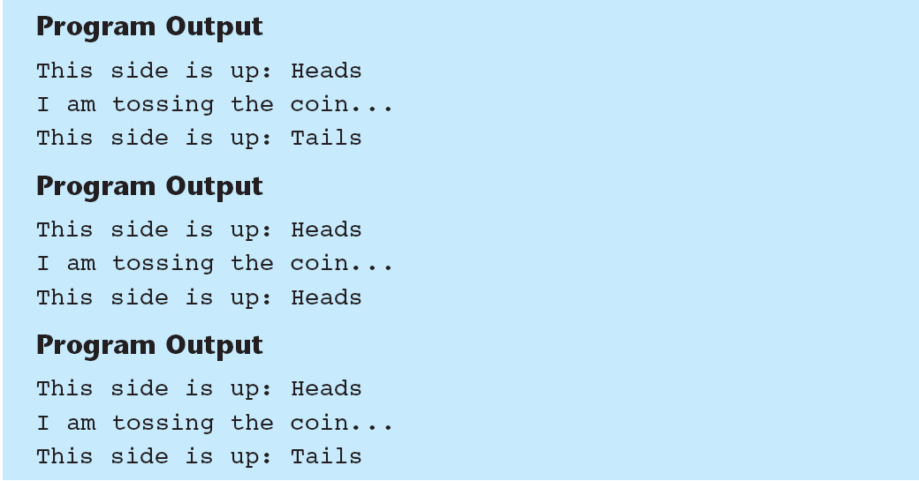

Slide 25
Coin Toss
Note that we did not have to pass an argument to the sideup method although it had the self parameter variable
When a method is called, Python automatically passes a reference to the calling object into the method’s first parameter
The self parameter will automatically reference the object that the method is to operate on
print (‘I am tossing the coin . . .’)
my_coin.toss ()
When this method executes, the self parameter will reference the my_coin object.

Slide 26
Hiding Attributes
In a class, an object’s data attributes should be private so that only the object’s methods can directly access them
This protects the object’s data attributes from accidental corruption
In the Coin class, the sideup attribute is not private. It can be accessed directly by statements that are not in a Coin Class method

Slide 27
Creates a coin object in memory
Display the side that is facing up
Toss the coin
Now change the side to “Heads”

Slide 28
Display the side that is facing up
Note the side always lands head up!
To prevent this we need to make the sideup attribute private
This is done by starting the variable name with two underscore characters

Slide 29
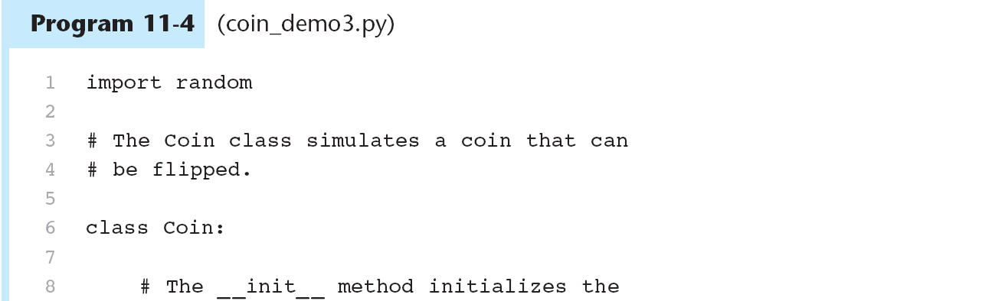
Creates sideup attribute as private

Slide 31
Storing Classes in Modules
Programmers frequently organize class definitions by storing them in modules
The modules can be imported into any programs that need to use the classes they contain

Slide 34
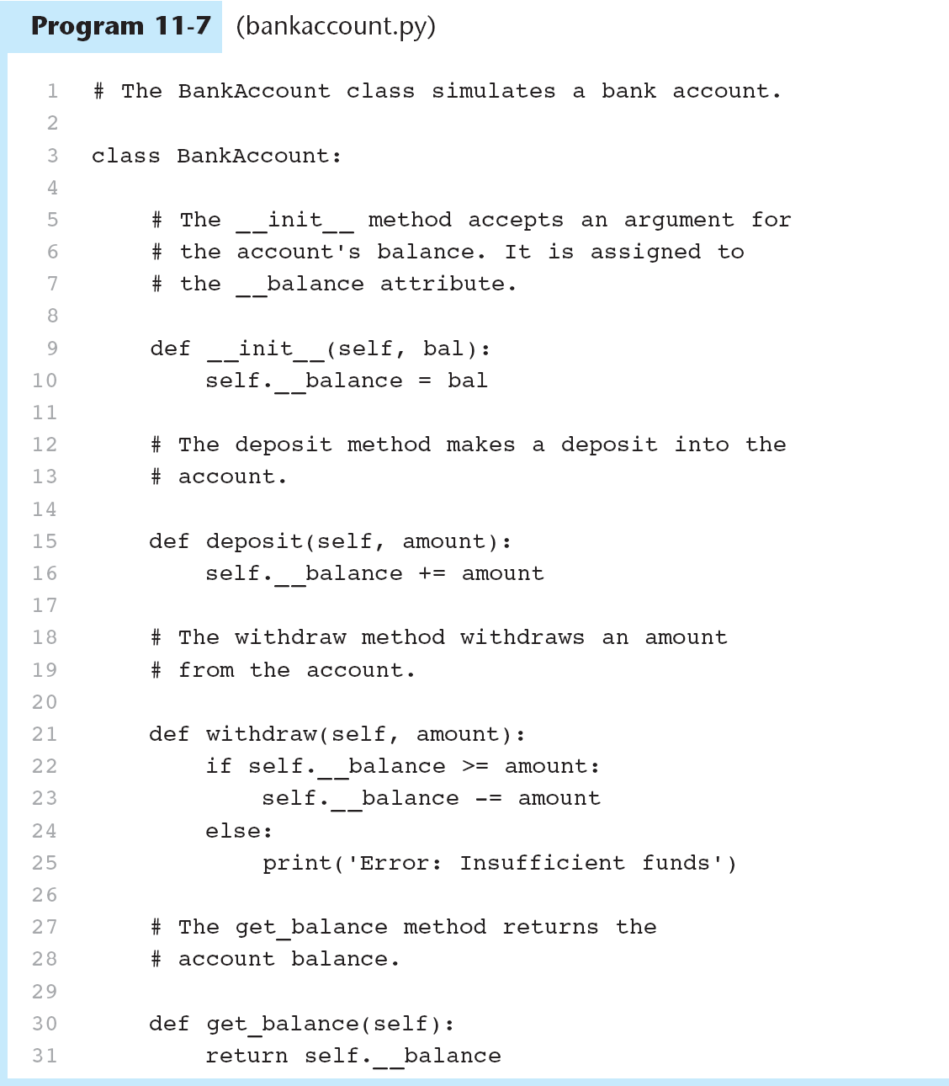
The Bank Account Class
Open bankaccount.py
And account_test.py

Slide 35
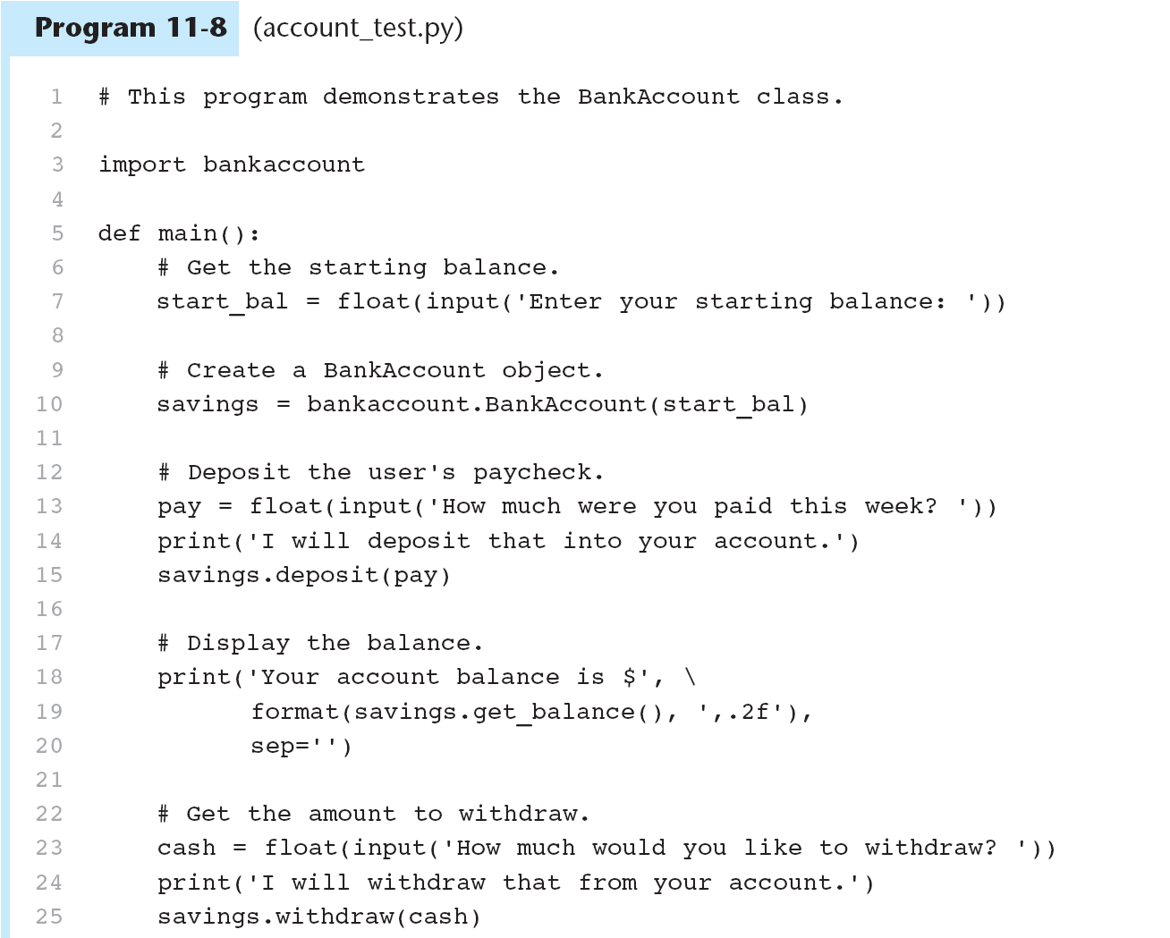

Slide 37
The __str__ method
Sometimes we need to display a message that indicates the object’s state or the values it contains at a given moment
For example, we might want to know the value of the data attribute __balance from the BankAccount object
This is so common a task that many times programmers include a method to display the object’s state
This method is given a special name __str__

Slide 38
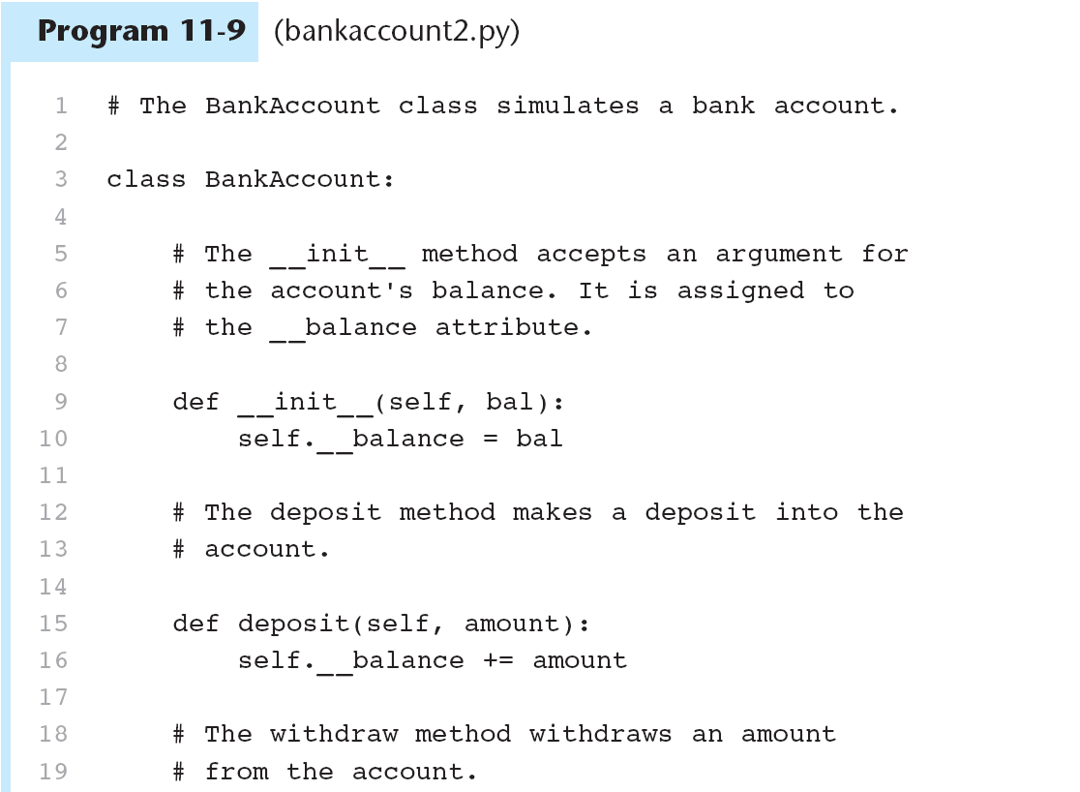

Slide 39
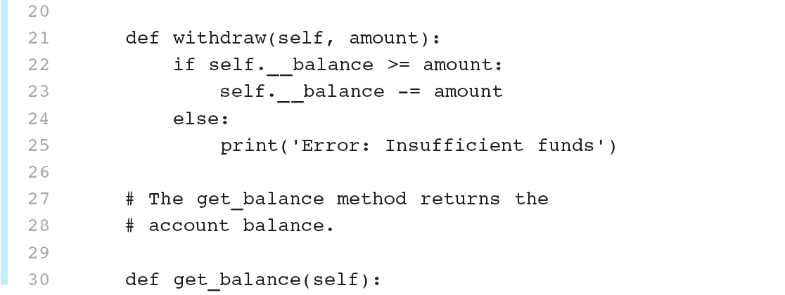

Slide 40
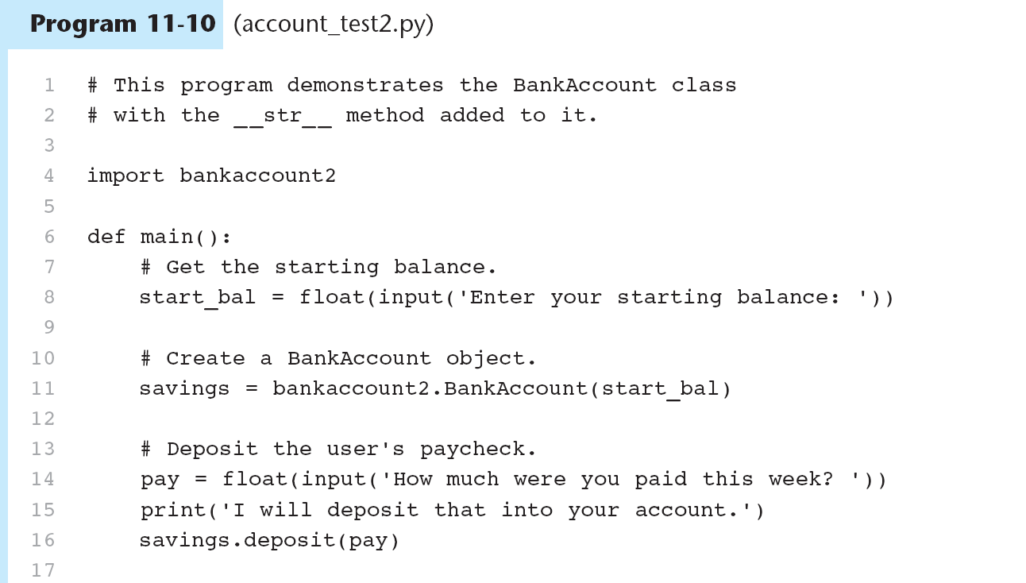

Slide 41
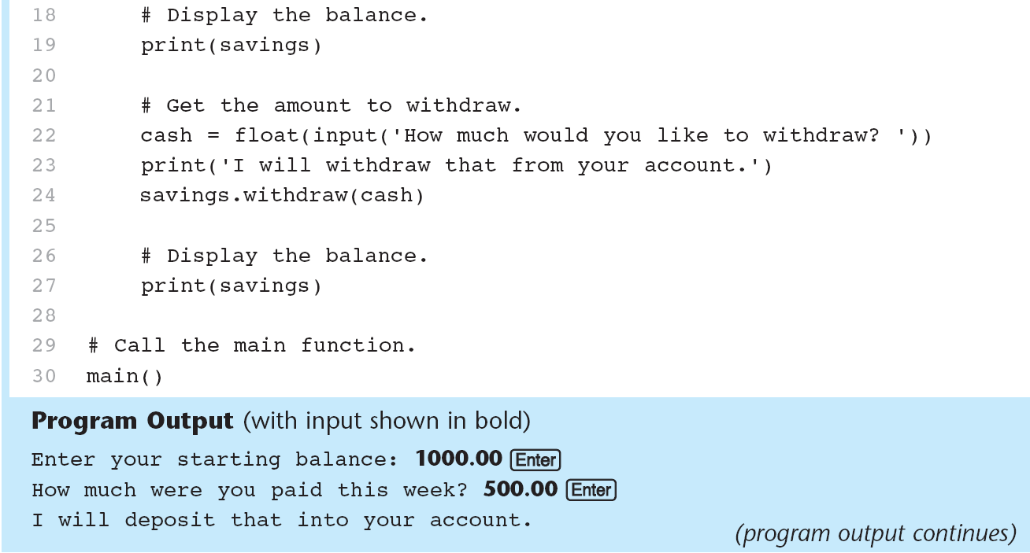
You do not directly call the __str__ method. It is automatically called when you use the print function

Slide 42
In Class Assignment Ch. 10 part 1– Answer these questions – see Short Answer p. 475
What is encapsulation?
Why should an object’s data attributes be hidden from code outside the class?
What is the difference between a class and an instance of a class?
The following statement calls an object’s method. What is the name of the method? What is the name of the variable that references the object?
wallet.get_dollar()
When the __init__ method executes, what does the self parameter reference?
In a Python class, how do you hide an attribute from code outside the class?
How do you call the __str__ method?

Slide 43
10.3 Working With Instances
Each instance of a class has it’s own data attributes
When a method uses the self parameter to create an attribute, the attribute belongs to the specific object that self references
You can create multiple instances of the same class in a program, each with its own set of attributes
Open coin.py and coin_demo5.py

Slide 44
10.3 Working With Instances

Slide 45
11.3 Working With Instances

Slide 46
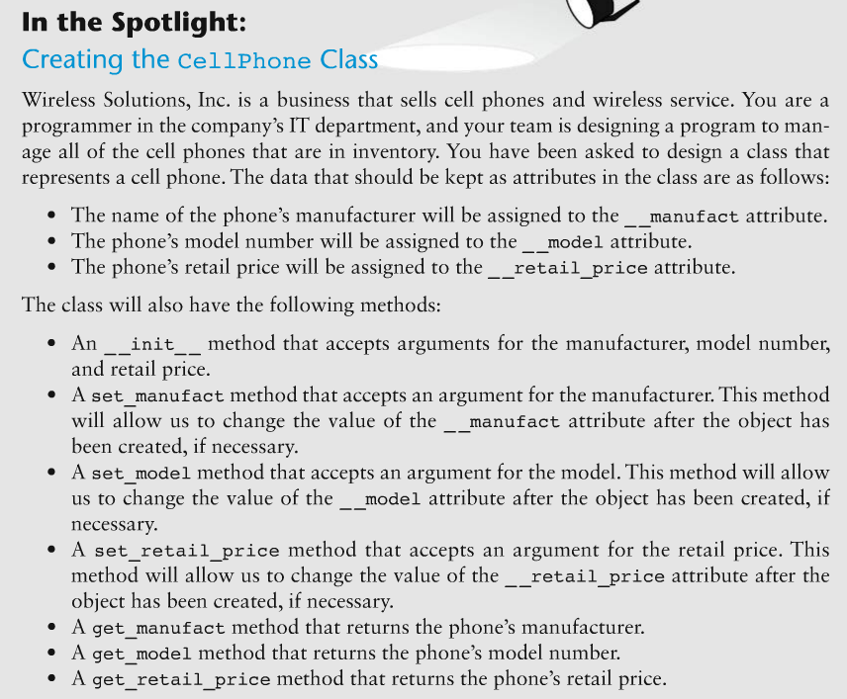
11.3 Working With Instances
Open cellphone.py and cell_phone_test.py

Slide 47
Accessor and Mutator Methods
It is a common practice to make all of a class’s data attributes private and to provide public methods for accessing and changing them
An accessor method is one that returns a value from a class’s attribute but does not change it
A mutator method stores a value in a data attribute or changes the value in some way. These control the way a class’s data attributes are modified.
Mutators methods are known as “setters” and accessor methods are known as “getters”
See Cellphone class again

Slide 48
Passing Objects as Arguments
Objects can be passed as arguments to functions:
def show_coin_status(coin_obj):
print(‘This side of the coin is up:’,\ coin_obj.get_sideup())
Example of creating a Coin object and passing to a function:
my_coin = coin.Coin()
show_coin_status(my_coin)
Open coin_argument.py
Note that what is passed to the function is a reference to the object, not the object itself

Slide 49
Storing Objects in A List
What if we want to store information for more than one cellphone?
See cell_phone_list.py

Slide 50
Techniques for Designing Classes
UML diagram: standard diagrams for graphically depicting object-oriented systems
Stands for Unified Modeling Language
General layout: box divided into three sections:
Top section: name of the class
Middle section: list of data attributes
Bottom section: list of class methods

Slide 51
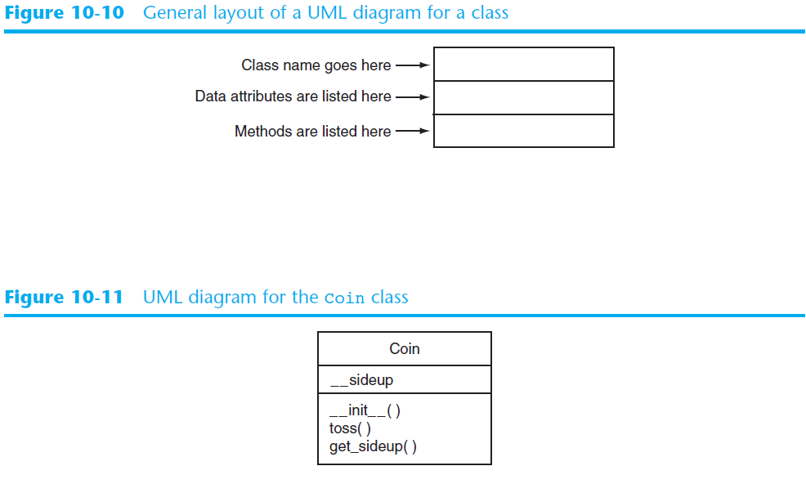

Slide 52
Finding the Classes in a Problem
When developing object oriented program, first goal is to identify classes
Typically involves identifying the real-world objects that are in the problem
Technique for identifying classes:
Get written description of the problem domain
Identify all nouns in the description, each of which is a potential class
Refine the list to include only classes that are relevant to the problem

Slide 53
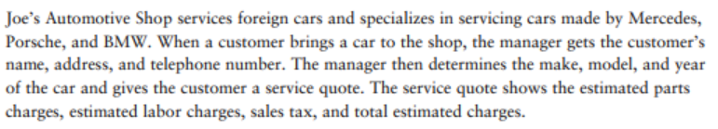
Finding the Classes in a Problem (cont’d.)
Get written description of the problem domain
May be written by you or by an expert
Should include any or all of the following:
Physical objects simulated by the program
The role played by a person
The result of a business event
Recordkeeping items

Slide 54
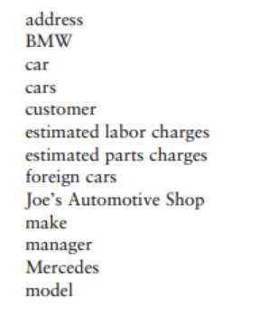
Finding the Classes in a Problem (cont’d.)
Identify all nouns in the description, each of which is a potential class
Should include noun phrases and pronouns
Some nouns may appear twice

Slide 55
Finding the Classes in a Problem (cont’d.)
Refine the list to include only classes that are relevant to the problem
Remove nouns that mean the same thing
Remove nouns that represent items that the program does not need to be concerned with
Remove nouns that represent objects, not classes
Remove nouns that represent simple values that can be assigned to a variable

Slide 56
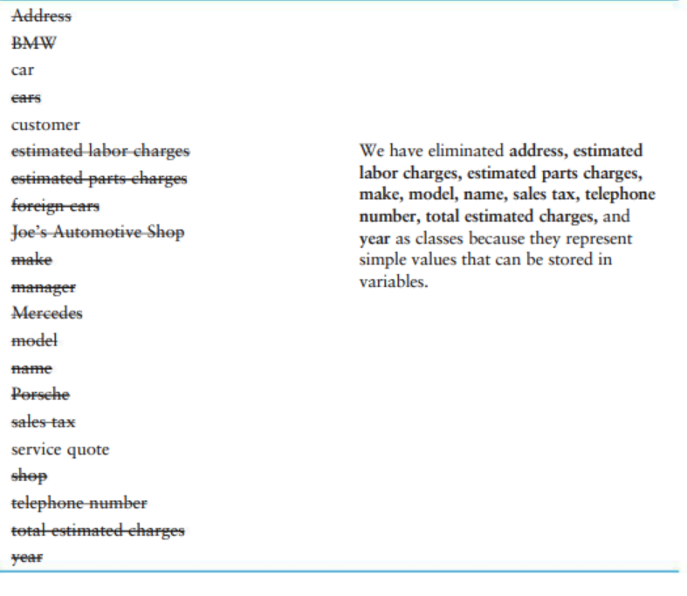

Slide 57
Identifying a Class’s Responsibilities
A classes responsibilities are:
The things the class is responsible for knowing
Identifying these helps identify the class’s data attributes
The actions the class is responsible for doing
Identifying these helps identify the class’s methods
To find out a class’s responsibilities look at the problem domain
Deduce required information and actions

Slide 58
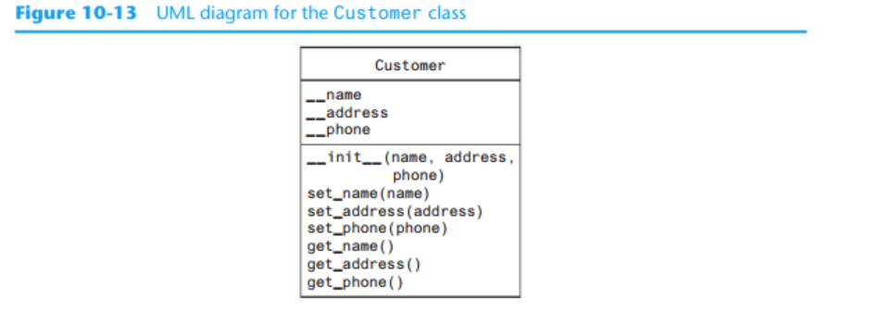

Slide 59
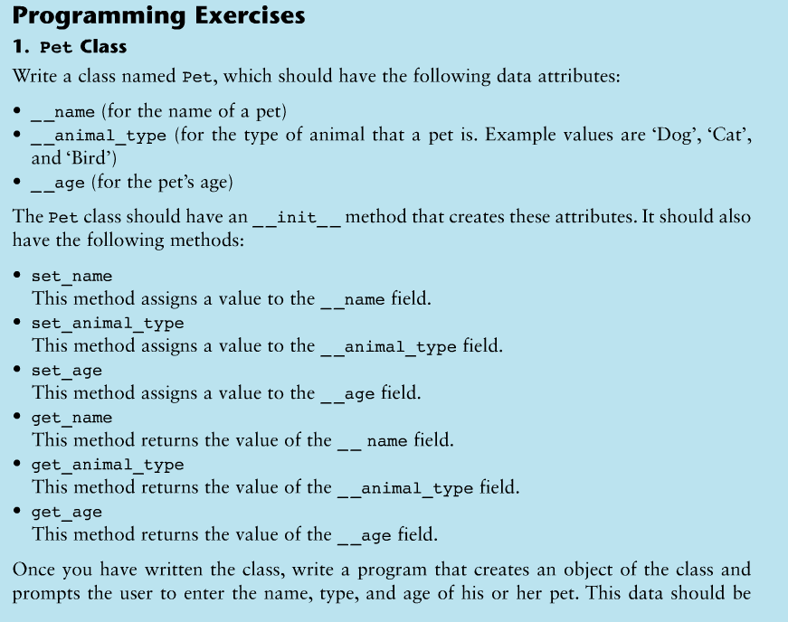
Ch. 10 In Class Assignment Part 2
Work in groups of 2. One person writes the class, one writes the program to implement the class.
You should have 2 files:
One for the class
One for the class implementation (main program)

